Slide 1

Examination of the Influence of Technical Skills Training on Technology Advancement in Government Organizations
John Morse
AS.470.708 Unleashing Open Data with Python
Advanced Academic Program, Johns Hopkins University
May 2023
Notes:
The success or failure of technological solutions within a professional organization or public institution is dependent on many factors going into the project itself. Variables as diverse as process, governance, financial investment, and executive sponsorship have direct influence. An often-overlooked factor, however, is the readiness and training of human resources beyond the simple communication of upcoming changes.

Slide 2
Research Question
Does the introduction of Technical Skills training at the employee level significantly improve the general maturity of an organization’s technical capability or the success of technology-based projects in that organization?
HA₀ [NULL]: The introduction of internal employee training programs on technology and data have no impact on the technological maturity of an organization.
HA₁: Introducing internal employee training programs on technology and data improve the overall technological maturity of an organization.
HB₀ [NULL]: The introduction of internal employee training programs on technology and data have no impact on the success rate of specific technology projects implemented within an organization.
HB₁: Introducing internal employee training programs on technology and data improve the success rate of specific technology projects implemented within those organizations.
Notes:
In this analysis, I have examined two separate, though related, hypotheses. In general, I sought to determine if the introduction of Technical Skills training to employees within an organization improve the technical capability of that organization.
This slide provides more formal hypotheses, but to summarize, I am asking two questions:
Does the introduction of employee training programs within an organization improve the overall technological maturity of the organization (i.e. its relevance as a technically capable organization).
Does the introduction of employee training programs within an organization improve the success rate of technology related projects conducted within that organization.

Slide 3
Background – Literature Review
“management practices are positively, strongly and significantly related to measures of business success” – Jakob Schneebacher
“the capability of drawing, holding and advancing employees that are talented are the main characteristics of a business that is successful” – George Ochola
“employee training has a significant positive effect on organizational commitment” – Jalal Hanaysha
“calculations found strong significant associations between those employees who … had updated training and subsequent positive training attitudes, as well a feeling of increased job proficiency” – Debra Truitt
“Training and Development, On the Job Training, Training Design and Delivery style have significant affect on Organizational Performance” – R.A. Khan, et. al.
Notes:
Employee training, though often included as part of the scope of overall management practices, has not been examined in depth in terms of its direct influence on the success of an organization as measured by that organization’s performance or the measured success of individual projects. For this analysis, I reviewed five articles that examine the relationship of at least one aspect of employee enablement and the work-environment as a whole.
These articles examine a range of influencers related to management, employee motivation, employee empowerment, and skills training. Of the articles I reviewed, though, only the article by R.A Khan and his team drew a direct correlation between employee training and business success, and none of these articles covered the subject of project success. I felt this left an opportunity to examine these relationships in more depth.
#######################################################################################
In his review of management practices in Great Britain, Jakob Schneebacher includes training as part of the broader category of management practices, concluding good management improves business success.
George Ochola, in an article published in 2018, concluded that employee motivation can directly influence business success. Training was one of several factors considered under the topic of motivation.
Jalal Hanaysha examines employee empowerment, teamwork, and employee training and determines, through surveys, that all three influence an employee’s commitment to an organization, though he does not touch on organizational success.
Debra Truitt does extensive analysis of the influence of employee development through training and coaching. Her findings emphasize the employee’s attitudes about their own work proficiency, though, another sign of motivation, rather than the influence on the organization.
Published the same year as Truitt’s analysis, R.A. Khan and his team do examine the influence of employee training on employee performance, and also draw a connection from that performance and the organization’s performance.
Ultimately, only Khan looks at the direct relationship of employee training and business success, and none of these articles covered the subject of project success.

Slide 4
Background – World Bank GovTech Data
Independent variables of interest
Original Name | Project Name | Description | Values
I-45 | DS_Strategy_Program | Is there a government strategy/ program to improve digital skills in the public sector? | 0 = No, 1 = Yes (Only strategy or program), 2 = Yes (Both strategy and program)
I-45.4 | FocusArea | Focus areas of the DS strategy | 0 = Unknown, 1 = Basic digital skills, 2 = Basic digital skills + Data literacy, 3 = Advanced digital skills + Data literacy
I-45.5 | DSProgram | Is there a DS program? | 0 = No, 1 = Yes
I-45.5.1 | DSProgramType | If Yes > Type of primary DS program(s) | 1 = Academic program, 2 = Public sector program, 3 = CSO/Private program
I-45.5.3 | DSProgramMandatory | If Yes > DS program mandatory for new public employees? | 0 = Unknown, 1 = Not mandatory, 2 = Mandatory
I-45.6 | DSProgramExternal | Are there digital skills programs offered by governments for citizens/schools? | 0 = No, 1 = Yes (fee-based programs), 2 = Yes (freely available programs)
I-45.7 | DSProgramPublished | Publishing of the results/progress in DS programs? | 0 = No, 1 = Yes (internal, not published), 2 = Yes (public, published)
Dependent variables
Original Name | Project Name | Description | Values
GTMI | GTMI | GTMI score | 0 to 1
ICROut | ICROutcome | Implementation Completion Report (ICR) Project Outcome rating – based on assessment completed within 6 months after closure of project by WBG project team | Standard ICR ratings : HS / S / MS / MU / U / HU Converted to 1 = Satisfactory, 0 = Unsatisfactory
IEGOut | IEGOutcome | Independent Evaluation Group (IEG) Project Outcome rating = based on a review within 6 months after delivery by independent review board for validation. | Standard ICR ratings : HS / S / MS / MU / U / HU Converted to 1 = Satisfactory, 0 = Unsatisfactory
Notes:
All data for this analysis was obtained through published Excel files provided by the World Bank Group, either through their annual GovTech Maturity Index (GTMI) Update or the Digital Governance Projects Database.
The GTMI is a report on the state of Technology services and solutions as implemented by central governments throughout the world and includes 198 world economies. The Digital Governance Projects Database provides details of 1,449 projects funded by the WBG in 147 countries.
Independent variables for this analysis came from the GovTech Maturity data and provide seven different assessments of Technical Skills enablement within a program.
I had three dependent variables through which I performed linear and logistic regression: The GovTech Maturity Index, or GTMI score, and two separate project success ratings: ICR Outcome and IEG Outcome. An ICR Outcome, Implementation Completion Report, is an evaluation done at the completion of the project and represents an assessment of the project itself. An IEG, or Independent Evaluation Group evaluation, is a review of the ICR and associated materials completed within six months after the project ends to provide a secondary independent evaluation of the success of the project.

Slide 5
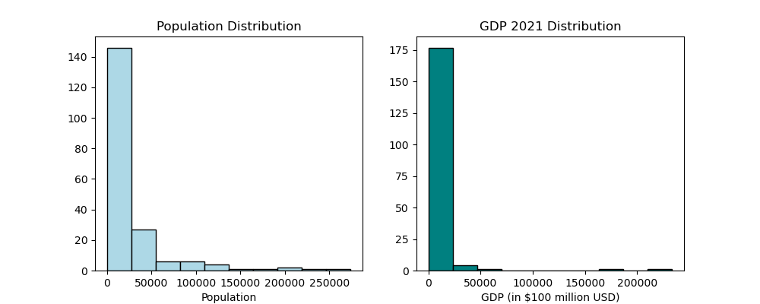
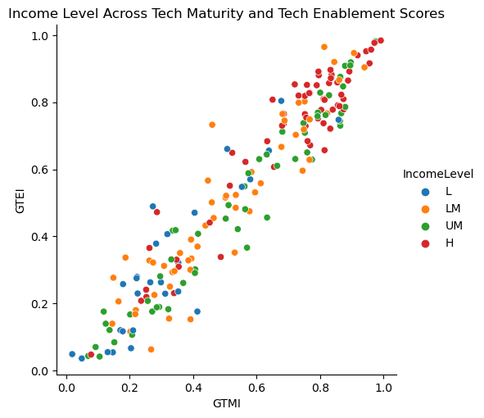
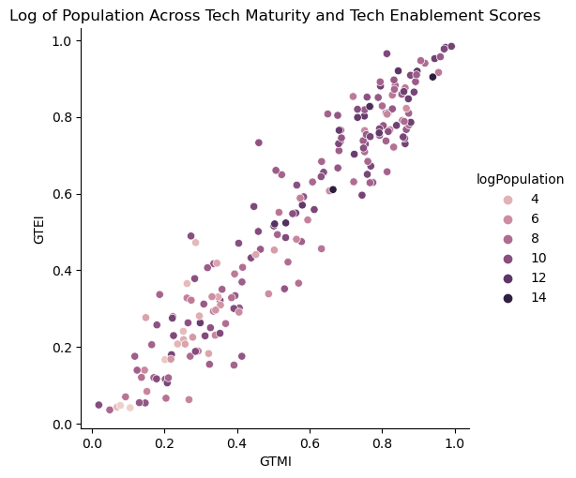
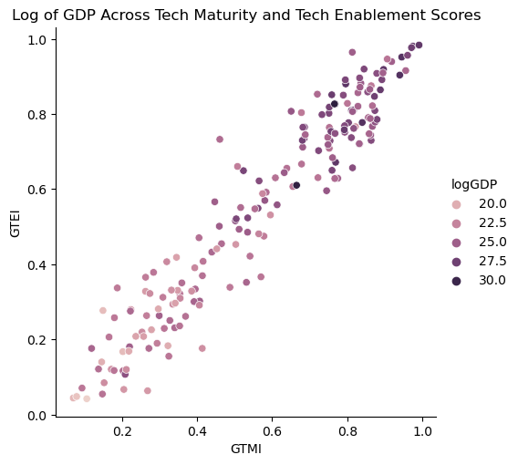
Analysis – Controlling for Omitted Variable Bias
Notes:
Because of the wide range of countries included in the GovTech research, I felt it important to control for variables that might account for disparities in technical capability and project success not directly related to the introduction of technical skills within each government organization. The GovTech Maturity research included both population size, and a categorical variable indicating income level: Low income, lower middle, upper middle, and high income. Additionally, through the WBG site, I was able to obtain Gross Domestic Product for most countries included in the GovTech Maturity program.
Income Level proved to be well dispersed across the countries, and the categorical values were converted to dummy variables through one-hot encoding. However, both Population and GDP were highly skewed, as can be seen in the top two bar charts, and were converted to logarithmic values, which demonstrated a more dispersed distribution across the target variables.

Slide 6
Analysis – Linear Regression on GTMI and GTEI
 | Simple Regression | Simple Regression w/ Control | Complete Regression
Dependent variable | GTMI | GTMI | GTMI
Intercept | 0.0668 (0.012) | 0.0033 (0.153) | -0.3613 (0.285)
GTEI | 0.9053* (0.020) | 0.8576* (0.029)
DS_Strategy_Program |  |  | 0.0359 (0.022)
FocusArea |  |  | 0.0267* (0.012)
DSProgram |  |  | -0.0443 (0.058)
DSProgramType |  |  | 0.0634* (0.024)
DSProgramMandatory |  |  | 0.0233 (0.023)
DSProgramExternal |  |  | 0.0300 (0.018)
DSProgramPublished |  |  | 0.0215 (0.015)
logPopulation |  | 0.0068 (0.012) | 0.0195 (0.022)
logGDP |  | -0.0002 (0.011) | 0.0185 (0.021)
IL_LM |  | 0.0201 (0.023) | 0.0658 (0.043)
IL_UM |  | 0.0648* (0.033) | 0.1732* (0.061)
IL_H |  | 0.0504 (0.048) | 0.2180* (0.090)
R-Squared | 0.9124 | 0.924 | 0.756
Adj. R-Squared |  | 0.922 | 0.739
Observations | 198 | 184 | 184
* Indicates significance at 95% Confidence Level
Notes:
The goal of my first analysis was to assess to what extent the Tech Skills enablement variables influence the overall Tech maturity of a government organization. With GTMI as the dependent variable, I used Ordinary Least Squares regression. As part of the exploration, I started with a simple regression of the GTMI score based on the overall GovTech Enablement score, GTEI, which is made up of 42 separate enablement scores, including the seven Tech Skills enablement variables. I then built on that analysis to perform a complete regression of GTMI.
The regression outcomes of the complete regression models with all independent variables indicate significant results (at the 95% Confidence Level) for FocusArea, an indication of the type of Tech Skills provided, and DSProgramType, an indication of the type of learning program provided. However, the coefficient on both variables is small: 0.0267 for FocusArea on the GTMI regression, and 0.0634 for DSProgramType. This indicates that these variables have a definite influence on the GTMI and GTEI scores, but that it is only a small influence.

Slide 7
Analysis – Logistic Regression on Project Success
Partial Classification Report: ICR Outcome from Logit Model
Value | Precision | Recall | # actual values
0 | 0.00 | 0.00 | 186
1 | 0.81 | 1.00 | 813
Partial Classification Report: IEG Outcome from Logit Model
Value | Precision | Recall | # actual values
0 | 0.38 | 0.01 | 321
1 | 0.68 | 0.99 | 678
Precision = accuracy of a predicted positive outcome – when a value of 1 is predicted, what percentage of the scores were actually 1?
Recall = ability of model to predict a positive outcome – if the value is 1, at what rate was a value of 1 predicted?
Notes:
As discussed previously, Project Success is recorded by one of two project evaluation variables: ICR Outcome and IEG Outcome. These are categorical variables with six possible values. The three Unsatisfactory values were grouped and given a value of 0 while the three Satisfactory values were grouped and given a value of 1. Logistic regression was done twice for each of the Outcome variables, once through a General Linear Model, and once through a Logit model.
With the logistic models, no coefficients show significance at the 95% level, indicating no influence on project success. Of note in these models was the large number of negative coefficients, indicating any influence would reduce the probability of success.
More importantly for these Logistic models is the prediction of success based on these models. Classification Reports are provided for the Logit models, and the GLM models provided the same results. For the ICR Outcome variable, the model simply predicted 1 for all observations. The IEG Outcome models did only slightly better. In fact, neither model predicted a Satisfactory or Unsatisfactory score accurately, indicating either the model itself is not valid, or the independent variables do not influence the project success rate.

Slide 8
Conclusion
Technical Skills enablement does not influence the overall maturity of a government’s technical capability.
Technical Skills enablement does not predict project success within government organizations.
Notes:
Contrary to my expectations, there is no significant evidence of the enablement of Tech Skills strategies or programs improving the outcome of either the general Tech Maturity of an organization, or the likelihood of the success of a Technology project within an organization. The influence of the Tech Enablement variables on the GTMI score for countries in the WBG report showed significance for only 2 variables, and the coefficient for those was small enough that it would not shift the GTMI score at a level that substantially mattered for the WBG report.
For Project Success, the Logistic models did not perform well for predicting success rates for either of the success metrics.

Slide 9
Further Research
Three clear options for further exploring these regression models:
Additional work with the models themselves
Refining the independent variables included based on initial results.
Analysis of Income Level on Tech Maturity
Upper-Middle Income and High Income Levels showed significance at the 95% level
Regression across GTMI Maturity Groups (A, B, C, D)
Notes:
If I were to continue working with this data, I see three distinct opportunities for further exploring relationships.
First, the models themselves could be further refined, removing variables clearly not impacting the outcome, and focusing on those variables with higher coefficients.
Secondly, the Income Level dummy variables demonstrated some of the highest coefficients, with both Upper-Middle and High income dummy variables showing significant influence on the GTMI scores. A follow up investigation of Income Level on Tech Maturity may reveal more interesting results.
Finally, I would like to evaluate regression outcomes across the groups identified by the WBG report. Based on the GTMI score, WBG identifies a grouping – A, B, C, or D - of the country in terms of its GovTech maturity. Theoretically, countries scoring higher in the GTMI would be more likely to have implemented a Digital Skills program and have a higher rate of success on projects. Thus, an analysis at the group level may show more significant results within those groups.

Slide 10
Thank you!
Notes:
Thank you for the opportunity to present my research and conclusions. I would like to thank the instructor of this class, Professor Renn, for his guidance and assistance throughout the course. I would also like to thank Professor Paschall for the content material used within the course. This experience has provided skills and knowledge that I will be able to directly apply to my work, and I appreciate the opportunity to study this topic through Johns Hopkins.

